Slide 1
Introduction to Node.js

Slide 2

Modules
Tools
What is Node.js?
What is JavaScript?
Node Package Manager (NPM)
Building Web API’s using Node.js
Unit testing
Working with data
Building IoT solutions using Node.js
Building Web apps using Node.js
Hosting Node.js in the cloud

Slide 3
You should have installed…
… Node.js
… Visual Studio Code
… Chrome
… Postman
… MongoDB
… Git
… and created an account for microServiceBus.com

Slide 4
Setup of this course
Course material at http://bit.ly/xlent-nodejs
./manuals – Hands on labs (HOL) manuals
./start – files required for some of the labs
./completed – completed labs
Create a folder e.g. ”Introduction to Node.js”
Clone the Git repo or download the zip locally
Create a local folder for all labs e.g. “Labs”

Slide 5



Tooling
Visual Studio
Visual Studio Code
Cloud 9 (online)
Sublime Text

Slide 6

What is Node.js?
Node.js® is a JavaScript runtime built on Chrome's V8 JavaScript engine.
Node.js uses an single threaded, event-driven, non-blocking I/O model that makes it lightweight and efficient.
Node.js is platform independent.

Slide 7
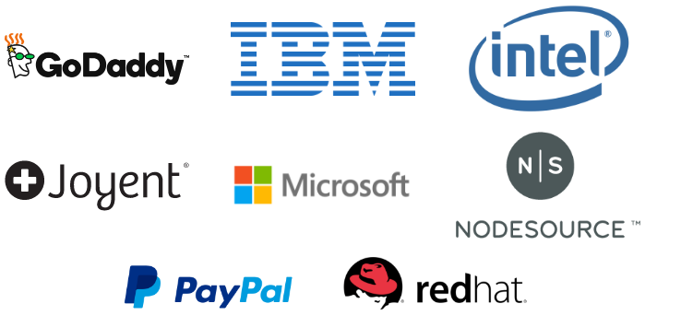
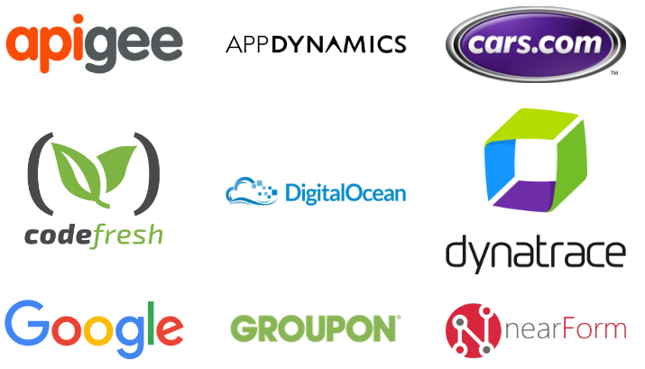
What is Node.js?
The project
The Node.js project is supported by the Node.js Foundation
Sourced at Github
Managed under an open governance model

Slide 8
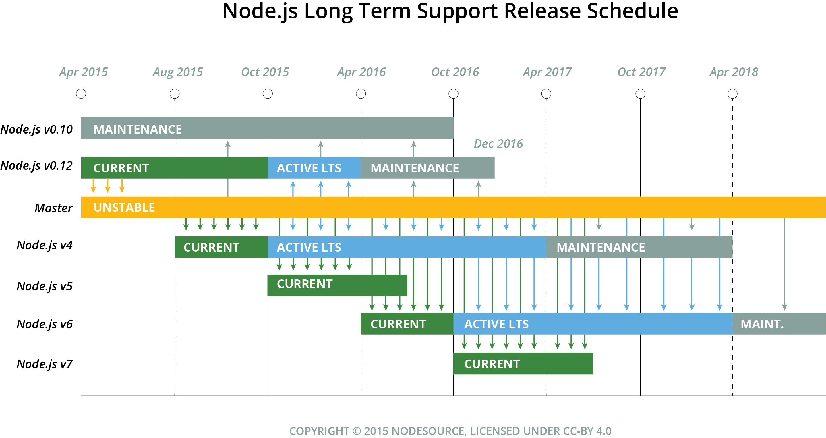
What is Node.js?
Versioning
CURRENT - Released from active development branches of this repository
LTS - Releases that receive Long-term Support (18 + 12 months)
LTS Status | Release | LTS Start | Maintenance Start | LTS End
Maintenance | v0.10 | - | 2015-10-01 | 2016-10-31
Maintenance | v0.12 | - | 2016-04-01 | 2016-12-31
Active | v4 | 2015-10-01 | 2017-04-01 | 2018-04-01
N/A | v5 | N/A
Pending | v6 | 2016-10-18 | 2018-04-18 | 2019-04-18

Slide 9
What is Node.js?
APPLICATION
NODE.JS
BINDINGS
(NODE API)
LIBUV
(ASYNCHRONOUS I/O)
JAVASCRIPT
EVENT QUEUE
WORKER THREADS
BLOCKING OPERATION
V8
(JAVASCRIPT ENGINE)
FILE
NETWORK
OS OPERATIONS
EVENT LOOP
PROCESS
EXECUTE CALLBACK

Slide 10

What is JavaScript?
A high-level, dynamic, untyped, and interpreted programming language. It has been standardized in the ECMAScript language specification
Notes:
High-level … förlåtande
Förklara att javascript är ett JIT kompilerat språk
var a = 2;
console.log(a);
3();

Slide 11

Last 10 years…
RUP && UML
C# || Java
SQL || Oracle
Hyper-V || Vmware
Out-sourcing
SOA
Agile && Scrum
JavaScript || Python
NoSql
Docker
Cloud
Micro services
Notes:
RUP SCRUM
Cycle 4 phases Each sprint is a complete cycle
Planning End-data driven No end-to-end project plan
Scope Defined at project start Project Backlog, which is re-evaluated at the end of each sprint.
Artifact Vision/Scope Document Operational software
Functional requirements
System architecture
Development plan
Test plan
Test scripts, etc.

Slide 12
Use chrome console…
a = b * 2;
”;” not necessary in the same way punctuations are not mandatory for us to understand a text
Show alert();
Make note of the fact that alert is a browser function not a javascript function. Same goes for prompt(). Use console.log…

Slide 13
JavaScript Syntax
Values and Types
Operators
Variables and Blocks
Conditional statemets
Loops
Functions
Notes:
Use chrome console…
a = b * 2;
”;” not necessary in the same way punctuations are not mandatory for us to understand a text
Show alert();
Make note of the fact that alert is a browser function not a javascript function. Same goes for prompt(). Use console.log…

Slide 14
JavaScript – Values and Types
Primitive values
Boolean
Number
String
Null
Undefined
Objects
Date
Structured data
Collections
Functions
Classes (ES6)
Notes:
var a = 12.12345;
var b = a.toFixed(2) / 1;

Slide 15
JavaScript – Values and Types
Dates
new Date();
new Date(value);
new Date(dateString);
new Date(year, month, day, hour, minutes, seconds, milliseconds);
If no arguments are provided, the constructor creates a JavaScript Date object for the current date and time according to system settings (UTC).
Date.now()
returns the numeric value corresponding to the current time - the number of milliseconds elapsed since 1 January 1970 00:00:00 UTC.

Slide 16
JavaScript – Values and Types
Structured data: JSON
var user = {
id: 1,
firstName: 'Jim',
lastName: 'Morrison'
};ions:
var numbers = [1, 2, 3, 4];

Slide 17

JavaScript – Values and Types
Explicit Conversions
String()
Number()
Implicit Conversion
var a = 12;
a = a + ' hours';
Notes:
var a = 12.12345;
var b = a.toFixed(2) / 1;

Slide 18
JavaScript - Operators
EQUAL
a = 1;
a = a + 2;
a += 2;
EQUALITY
a == b (loose-equals)
a === b (strict-equals)
a != b (loose-not-equals)
a !== b (strict-not-equals)
”falsy” values:
0
-0
””
false
null
undefined
if(error){
// handle error
}

Slide 19
JavaScript - Variables and Blocks
var a = 42; //(Function scope)
let b = 16; //(Block scope)
const AGE = 7;

Slide 20
JavaScript - Variables and Blocks
Block
var b = 4;
{
var t = 2;
console.log(b);
}
console.log(t);
var b = 4;
{
let t = 2;
console.log(b);
}
console.log(t);

Slide 21
JavaScript - Variables and Blocks
for (var a = 5; a < 10; a++) {
}
console.log(a);
for (let b = 5; b < 10; b++) {
}
console.log(b);

Slide 22
JavaScript - Loops
for
for (a = 5; a < 10; a++) {
// ...
}
while
while(condition){
// ...
}
foreach
numbers.forEach(function (n) {
console.log(n);
});

Slide 23
JavaScript - Functions
function add(x, y) {
return x + y;
}
var subtract = function (x, y) {
return x - y;
}

Slide 24
JavaScript - Functions
function foo(x) {
return ++x;
}
function bar(y) {
return ++y;
}
var z = foo(bar(40));

Slide 25
Time for callbacks….
Accept this…

Slide 26
function foo() { function bar() { // Do someting } bar(); };

Slide 27
function foo( var = function() { // Do someting }
) {
bar
bar(); };

Slide 28
function foo(
bar
) {
bar(); };
var do = function() { // Do someting }
foo(do);
!== foo(do(1));

Slide 29
let’s take a deep breath…
…anonymous callbacks

Slide 30
function foo(
bar
) {
bar(); };
foo(function() { // Do someting });
var do = function() { // Do someting }
foo(do);

Slide 31
JavaScript – Promises (Async programing)
function divide(x, y) {
try {
var z = x / y;
return Promise.resolve(z);
}
catch (e) {
return Promise.reject(e);
}
}
divide(4, 0)
.then(function (response) {
console.log("Success!", response);
}, function (error) {
console.error("Failed!", error);
});

Slide 32
Immediately Invoked Function Expressions (IIFEs)
(function IIFE(){
console.log( "Hello!" );
})();
// "Hello!"

Slide 33
JavaScript – modules
function Contact(first, last, phone) {
this.firstName = first;
this.lastName = last;
this.phoneNumber = phone;
this.name = function () {
return this.firstName + " " + this.lastName;
};
}
var theDude = new Contact("Jeff", "Bridges", "123456789");
console.log(theDude.name());

Slide 34
Prepare for lab…
Notes:
'use strict'
const VAT = 0.2;
const PRODUCTS = [
{id:1, name:"Fazer Kexchoklad", price:12.4},
{id:2, name:"Snickers", price:8.2},
{id:3, name:"Dajm", price:19.0}
]
var accountBalance = 10;
function buy(product, callback){
var tax = calculateVAT(product.price);
try{
withdraw(product.price);
console.log("You bought a "+ product.name +" for " + product.price+ " SEK");
console.log("VAT: " + tax.toFixed(2) + " SEK");
callback();
}
catch(err){
callback(err);
}
}
function calculateVAT(amount){
return amount * VAT;
}
function withdraw(amount){
if(amount > accountBalance){
throw "Insufficient funds."
}
accountBalance -= amount;
}
buy(PRODUCTS[2],function(err){
if(err){
console.log(err);
}
else{
console.log("You balance is " + accountBalance.toFixed(2) + " SEK");
}
});
// Expected output:
// You bought a Snickers for 8.2 SEK
// VAT: 1.64 SEK
// You balance is 91.8 SEK

Slide 35
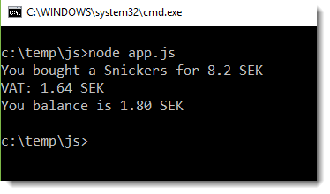
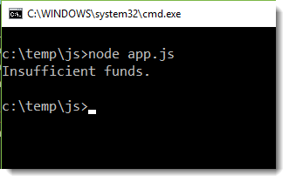
HOL #1 – JavaScript 101 …
const VAT = 0.2;
var products = [
{ id: 1, name: "Fazer Kexchoklad", price: 12.4 },
{ id: 2, name: "Snickers", price: 8.2 },
{ id: 3, name: "Dajm", price: 19.0 }
]
var accountBalance = 10;
function buy(product, callback) {/* YOUR CODE */ }
function calculateVAT(amount) {/* YOUR CODE */ }
function withdraw(amount) {/* YOUR CODE */ }
buy(products[1], function (err) {
if (err) {
console.log(err);
}
else {
console.log("You balance is " + accountBalance.toFixed(2) + " SEK");
}
});
Notes:
'use strict'
const VAT = 0.2;
const PRODUCTS = [
{id:1, name:"Fazer Kexchoklad", price:12.4},
{id:2, name:"Snickers", price:8.2},
{id:3, name:"Dajm", price:19.0}
]
var accountBalance = 10;
function buy(product, callback){
var tax = calculateVAT(product.price);
try{
withdraw(product.price);
console.log("You bought a "+ product.name +" for " + product.price+ " SEK");
console.log("VAT: " + tax.toFixed(2) + " SEK");
callback();
}
catch(err){
callback(err);
}
}
function calculateVAT(amount){
return amount * VAT;
}
function withdraw(amount){
if(amount > accountBalance){
throw "Insufficient funds."
}
accountBalance -= amount;
}
buy(PRODUCTS[2],function(err){
if(err){
console.log(err);
}
else{
console.log("You balance is " + accountBalance.toFixed(2) + " SEK");
}
});
// Expected output:
// You bought a Snickers for 8.2 SEK
// VAT: 1.64 SEK
// You balance is 91.8 SEK

Slide 36
HOL #1 – What is JavaScript?
Lab manual: /manuals/hol1.md
Create a course folder and name it ”Introduction to Node.js”
Copy the /start/hol1.js from the repo to your course folder.
Open a command prompt and navigate to the folder
Type ”npm init” and answer by hitting [enter]
Open code and navigate to your lab folder

Slide 38

Node Package Manager (NPM)
npm is the default package manager for the JavaScript runtime environment Node.js and allows users to consume and distribute JavaScript modules that are available on the registry.

Slide 39
Node Package Manager (NPM)
npm init
npm install {package} [{package}]
npm install {package} --save
npm install {package} --save-dev
npm publish
BTW… npm is a npm package…

Slide 40
Demo npm

Slide 41
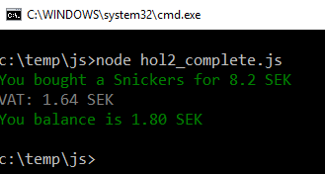
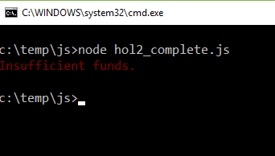
HOL #2 – Working with npm
Lab manual: /manuals/hol2.md
Browse to www.npmjs.com
Import the colors package
Provide an colour depending on the output.
Notes:
'use strict'
const VAT = 0.2;
const PRODUCTS = [
{id:1, name:"Fazer Kexchoklad", price:12.4},
{id:2, name:"Snickers", price:8.2},
{id:3, name:"Dajm", price:19.0}
]
var accountBalance = 10;
function buy(product, callback){
var tax = calculateVAT(product.price);
try{
withdraw(product.price);
console.log("You bought a "+ product.name +" for " + product.price+ " SEK");
console.log("VAT: " + tax.toFixed(2) + " SEK");
callback();
}
catch(err){
callback(err);
}
}
function calculateVAT(amount){
return amount * VAT;
}
function withdraw(amount){
if(amount > accountBalance){
throw "Insufficient funds."
}
accountBalance -= amount;
}
buy(PRODUCTS[2],function(err){
if(err){
console.log(err);
}
else{
console.log("You balance is " + accountBalance.toFixed(2) + " SEK");
}
});
// Expected output:
// You bought a Snickers for 8.2 SEK
// VAT: 1.64 SEK
// You balance is 91.8 SEK

Slide 43
Building Web API’s using Node.js
What is REST?
Using the express package
Building a service

Slide 44
What is REST
Use HTTP/HTTPS
Use Verbs - Eg GET, POST, PUT, DELETE
Use Status codes - Eg 200, 201, 400, 403, 404
Caller dictates formats – Eg Content-Type & Accept
…etc, etc, etc

Slide 45
Using the express package
Express is a minimal and flexible Node.js web application framework that provides a robust set of features to develop web and mobile applications. It facilitates the rapid development of Node based Web applications.

Slide 46
HOL #3 – Building Web API’s using Node.js
Get express and body-parser packages from npm
Add logic for GET, POST and DELETE (optional)
Use Postman to test:
GET http://localhost:8080/products
GET http://localhost:8080/products?id=1
POST http://localhost:8080/products
DELETE http://localhost:8080/products?id=2

Slide 47
HOL #3 – Building Web API’s using Node.js
Lab manual: /documentation/hol3.md

Slide 49
Unit testing
Commonly used npm packages for testing:
mocha - JavaScript test framework
chai - assertion library
istanbul - code coverage
jshint – for testing code conventions
npm – used for executing tests locally
Travis CI – Continuous Integration testing
The TDD (Test-Driven Development) method is the most commonly used approach when testing node applications.

Slide 50

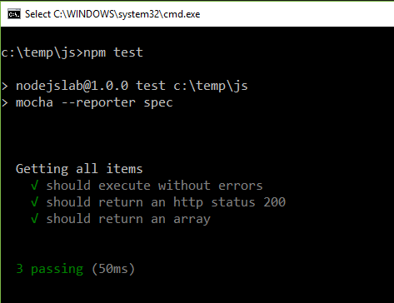
Test-Driven Development using mocha
describe("Getting all items", function () {
var products;
var error;
var statusCode;
before(function (done) {
request.get(options, function (err, res, body) {
products = JSON.parse(body);
statusCode = res.statusCode;;
error = err;
done();
});
});
it('should execute without errors', function () {
expect(error).to.equal(null);
});
it('should return an http status 200', function () {
expect(statusCode).to.equal(200);
});
it('should return an array', function () {
expect(products.length).to.be.above(0);
});
});
description: Getting all items
fact
it should execute without errors
it should return an http status 200
it should return an array

Slide 51
HOL #4 – Unit Testing
Lab manual: /documentation/hol4.md

Slide 53
Working with data
mongod (Mongo Deamon) -> Host
-dbpath [database folder]
-logpath [logfile]
--httpinstance –rest
-f [config file]
mongo -> Shell
-show dbs
-db
-use [db]
Notes:
Browse to mongo folder
Open a command prompt
Run mongod – veify it’s not working since it exprects a data/db folder
Run mongod –dbpath ./data point to the port 27017
Open second cmd and start mongo shell
Type use local
Type db.getCollectionNames()
Type db.createCollection(’…);
Type db.getCollectionNames()
Stop mongodb and start using mongod -dbpath ./data --httpinterface
Browse to http://localhost:28017/
Stop mongodb and start using mongod -dbpath ./data –httpinterface --rest
Browse to http://localhost:28017/

Slide 54
HOL #5 – Working with data
Lab manual: /documentation/hol5.md

Slide 56
Building and IoT solution using Node.js
What is IoT?
Why is Node.Js important for IoT?
IoT plattforms
IoT challenges
What is microServiceBus.com?
Notes:
Browse to mongo folder
Open a command prompt
Run mongod – veify it’s not working since it exprects a data/db folder
Run mongod –dbpath ./data point to the port 27017
Open second cmd and start mongo shell
Type use local
Type db.getCollectionNames()
Type db.createCollection(’…);
Type db.getCollectionNames()
Stop mongodb and start using mongod -dbpath ./data --httpinterface
Browse to http://localhost:28017/
Stop mongodb and start using mongod -dbpath ./data –httpinterface --rest
Browse to http://localhost:28017/

Slide 57

What is IoT?

Slide 58





Information distribution
Data collection
Integration
Configuration data
Reference data
Collect on-demand
Commands
Telemetry data
Big data
Point-of-sale
Alerts
LOB systems
Workflows
Routing
Databases & Queues
Security & Scale

Slide 59
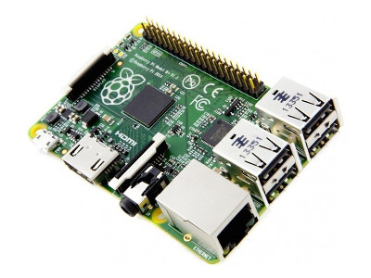
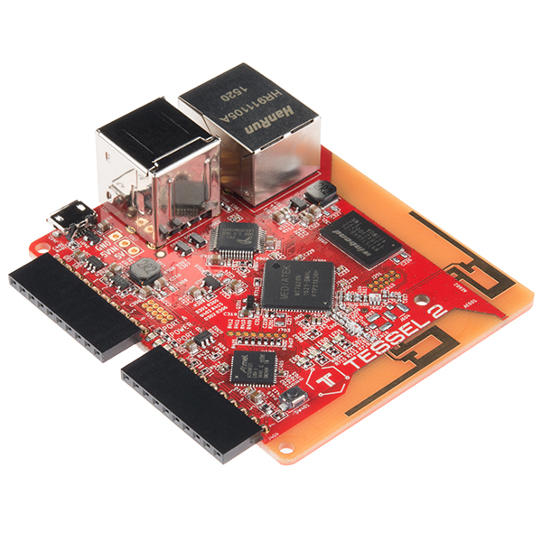
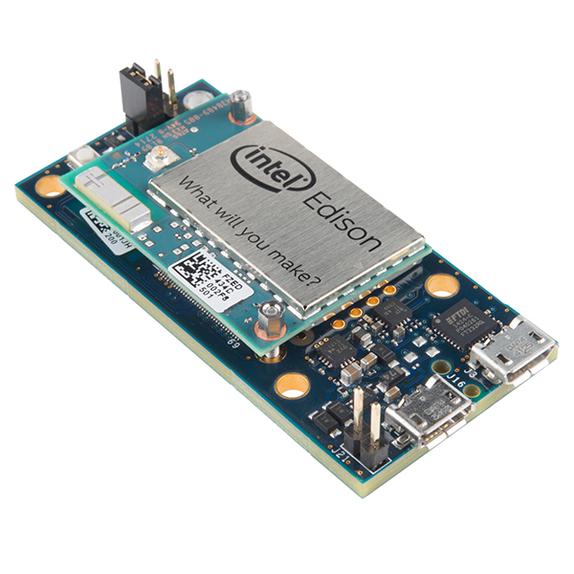
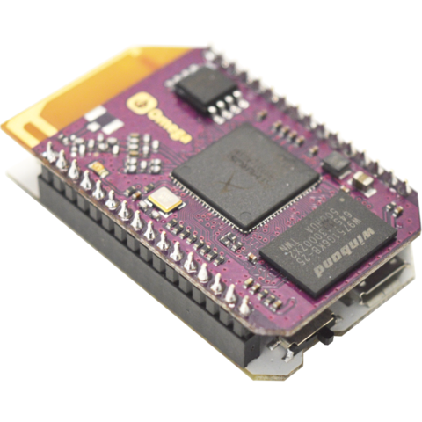

Building and IoT solution using Node.js
~$30
~$30
~$70*
~$25*
* With developer board

Slide 60





Agent

Slide 61

IoT plattforms
Reference architecture
Azure IoT, AWS IoT
AGENT
TRANSPORT
SECURITY
RULES & ROUTING
REPORTS
SDK
DATA
”AGENT”
GATEWAY
DEVICE MGMT
SDK
LOB
microServiceBus.com

Slide 62
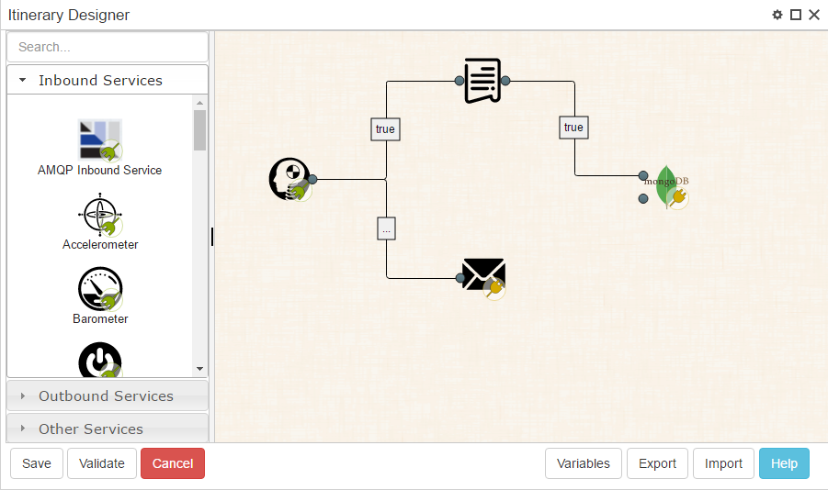
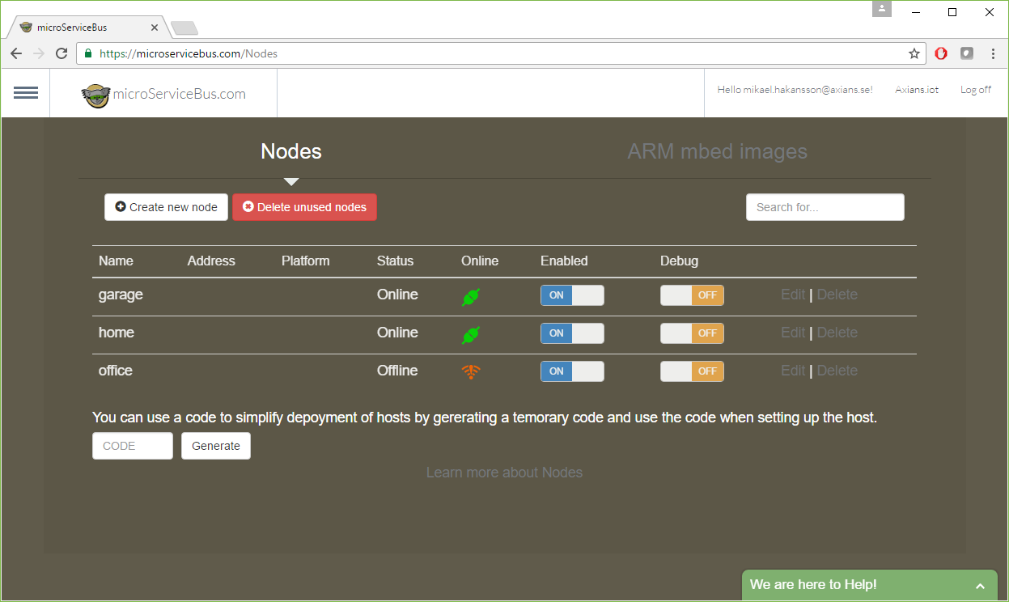
HOL#7
Toolbox
Routing
”home”
”garage”
”office”
”office”
Services

Slide 63
HOL #6 – Building and IoT solution using Node.js
Lab manual: /documentation/hol6.md

Slide 65
Building Web apps using Node.js
MVC application
User/Browser
Controller/API
Model
View

Slide 66
Building Web apps using Node.js
View Engines
./server.js
./controllers/homeController.js
./views/home/index.jade
app.set("view engine", “jade");
doctype
html
head
title= title
body
h1= title
p This is an express app!
footer This is the footer
app.get("/home", function(req,res){
var model = {title:"Welcome"};
res.render("home/index", model);
});

Slide 67
Building Web apps using Node.js
View Engines - mustache
./controllers/homeController.js
./views/home/index.mustache
<!doctype html> <html> <head> <meta charset="utf-8" /> <title>{{ title }}</title> </head> <body> <div> <h1>{{ title }}</h1> <p>This is an express app</p> </div> </body> </html>
app.get("/home", function(req,res){
var model = {title:"Welcome"};
res.render("home/index", model);
});

Slide 68
Building Web apps using Node.js
View Engines - ejs
./controllers/homeController.js
./views/home/index.ejs
<!doctype html> <html> <head> <meta charset="utf-8" /> <title><%- title%></title> </head> <body> <div> <h1><%- title%></h1> <p>This is an express app</p> </div> </body> </html>
app.get("/home", function(req,res){
var model = {title:"Welcome"};
res.render("home/index", model);
});

Slide 69
Building Web apps using Node.js
View Engines - vash
./controllers/homeController.js
./views/home/index.vash
<!doctype html> <html> <head> <meta charset="utf-8" /> <title>@model.title</title> </head> <body> <div> <h1>@model.title</h1> <p>This is an express app</p> </div> </body> </html>
app.get("/home", function(req,res){
var model = {title:"Welcome"};
res.render("home/index", model);
});

Slide 70


HOL #7 Building Web apps using Node.js
hol7 (copy from ./start)
controllers
data
views
Configure web server
Setting the view engine
Initializing controllers
server.js

Slide 71
HOL #7 Building Web apps using Node.js
hol7
controllers
homeController.js
Gets model
Calls to render home view
productController.js
data
Index.js
Creates the model
views
products
index.vash

Slide 72
HOL #7 Building Web apps using Node.js
Lab manual: /documentation/hol7.md
Open ./start/hol7 using VS Code
Install express, mongodb & vash

